Slide 1
Community Analysis Proposal Modelling of a Finite-Speed Thermal Wave in Solids using OpenFOAM
CSCI 5636: Numerical Solution of Partial Differential Equations
Student: Shrihari Ravichandran
Instructor: Prof. Jed Brown
Date: 10th November, 2023

Slide 2
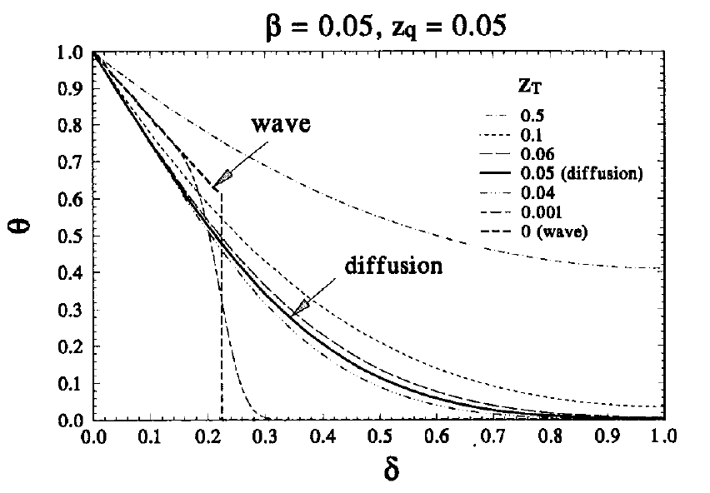


Physics of the problem
Heat propagates through phonons – modes of vibrations of atoms in a solid.
Usual approximation : assume an infinitely fast thermal wave i.e. Fourier’s Law of Heat Conduction.
$$−α∇^{2}T=\frac{∂T}{∂t}$$
$$−k∇T(r)=q(r)$$
Constitutive Relation
Governing Equation
Effect of phase lag(s) on temperature gradient at non-dimensional time β=0.05. δ is the non-dimensional coordinate, z is the non-dimensional phase lag. Source: Tzou et al., 1995.

Slide 3
Physics of the problem
Heat propagates through phonons – modes of vibrations of atoms in a solid.
Usual approximation : assume an infinitely fast thermal wave i.e. Fourier’s Law of Heat Conduction.
In certain cases, this is not valid : biological systems are a prime example.
We need to define a finite wave speed for such cases.
$$−α∇^{2}T=\frac{∂T}{∂t}$$
$$−k∇T(r)=q(r)$$
Constitutive Relation
Governing Equation

Slide 4

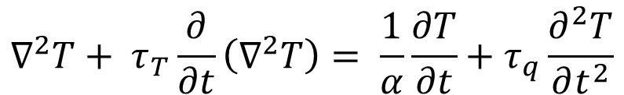
Physics of the problem
Incorporating a time delay in constitutive relation can solve the problem.
Time delay (or phase lag) accounts for microscopic effects like electron-phonon and phonon-phonon interactions in solids.
τ_{T} = phase lag in temperature
τ_{q} = phase lag in heat flux
$$−k∇T(r,t+τ_{T})=q(r,t+τ_{q})$$
New Constitutive Relation
$$∇^{2}T+ τ_{T}\frac{∂}{∂t}\left(∇^{2}T\right)= \frac{1}{α}\frac{∂T}{∂t}+τ_{q}\frac{∂^{2}T}{∂t^{2}}$$
New Governing Equation

Slide 5
Physics of the problem
Incorporating a time delay in constitutive relation can solve the problem.
Time delay (or phase lag) accounts for microscopic effects like electron-phonon and phonon-phonon interactions in solids.
τ_{T} = phase lag in temperature
τ_{q} = phase lag in heat flux
$$−k∇T(r,t+τ_{T})=q(r,t+τ_{q})$$
New Constitutive Relation
$$∇^{2}T+ τ_{T}\frac{∂}{∂t}\left(∇^{2}T\right)= \frac{1}{α}\frac{∂T}{∂t}+τ_{q}\frac{∂^{2}T}{∂t^{2}}$$
New Governing Equation

Slide 6
Physics of the problem
Incorporating a time delay in constitutive relation can solve the problem.
Time delay (or phase lag) accounts for microscopic effects like electron-phonon and phonon-phonon interactions in solids.
τ_{T} = phase lag in temperature
τ_{q} = phase lag in heat flux
$$−k∇T(r,t+τ_{T})=q(r,t+τ_{q})$$
New Constitutive Relation
$$∇^{2}T+ τ_{T}\frac{∂}{∂t}\left(∇^{2}T\right)= \frac{1}{α}\frac{∂T}{∂t}+τ_{q}\frac{∂^{2}T}{∂t^{2}}$$
New Governing Equation

Slide 7
OpenFOAM Essentials
What is OpenFOAM?
An open-source package to solve PDEs using Finite Volume Method.

Slide 8
OpenFOAM Essentials
What is OpenFOAM?
An open-source package to solve PDEs using Finite Volume Method.
Who uses OpenFOAM?
- Wide user base – industry professionals, scientists, students
- Problems solved – fluid mechanics, heat transfer, solid mechanics (limited), turbomachinery, electromagnetics, and many more.

Slide 9
OpenFOAM Essentials
What is OpenFOAM?
An open-source package to solve PDEs using Finite Volume Method.
Who uses OpenFOAM?
- Wide user base – industry professionals, scientists, students
- Problems solved – fluid mechanics, heat transfer, solid mechanics (limited), turbomachinery, electromagnetics, and many more.
Why OpenFOAM?
- Open-source: one can tweak source-code to suit their purposes.
- Validated for numerous cases and is being validated for many others.
- Ability to solve stiff problems using discretization schemes of your choice.
- Structured! No need to break the entire package to solve a new problem.

Slide 10
OpenFOAM Statistics
Year of founding : 2004
Number of contributors : 8 (contributions are heavily regulated)
Number of distinct affiliations : 6
How does the project accept contributions : Signing the OpenFOAM contributor agreement, Github commits.
Automated test suite? : in the dev version, yes.
Continuous integration? : yes
Legal/licencing steps? : yes.
Language: C++

Slide 11
References
Da Yu Tzou, The generalized lagging response in small-scale and high rate heating, International Journal of Heat and Mass Transfer 38(17) (1995) 3231.
https://www.openfoam.com/documentation/guides/latest/doc/guide-fos-field-ddt.html
https://www.openfoam.com

